Slide 1
CMPSC 100
Computational Expression

Slide 2
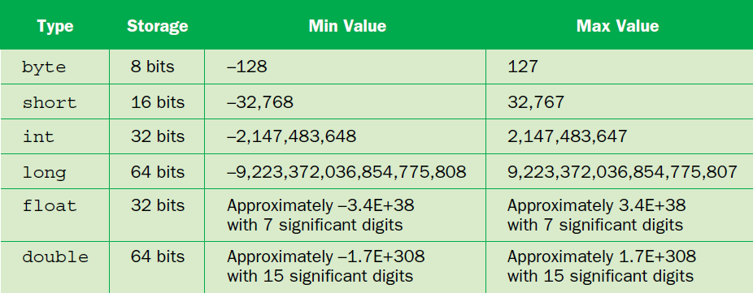
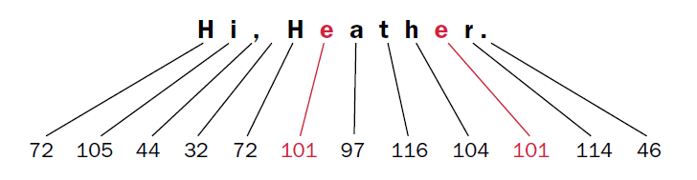
Recap
Primitives
Strings as non-primitive

Slide 3
Primitives aren’t “type-cast”
/** The entry point.
*
* @param args The command line arguments
*/
public static void main(String[] args) {
int a = Integer.parseInt(args[0]);
}

Slide 4
Data conversion
Because String type variable aren’t primitive, the capital “S” in the type indicates that it comes from a library (due to naming convention)
String is part of the JAVA API—core functionality packaged with Java releases to make them viably useful
Similarly, we have parts of the API like Integer or Double
These provide services that allow us to convert one primitive type to another with additional functionality

Slide 5
A simple problem
String count = “6”;
int sum = 600;
int average = sum / count
ERROR!

Slide 6
Data conversion
Variables acquire/inherit types four ways:
Assignment
int count = 6;
Promotion
double count = 11.0;
double average = sum / count;
Casting
int count = 11;
double average = sum / (double)count;
Parsing
String number = args[0]; // args[0] = “6”
int count = Integer.parseInt(number);

Slide 7
Arguments and input
/** The entry point.
*
* @param args The command line arguments
*/
public static void main(String[] args) {
int a = Integer.parseInt(args[0]);
}

Slide 8
Arguments and input
gradle run --args=“100”
==
java JavaProgram 100

Slide 9
Arguments and input
(There is.)
“There has to be a different way.”
Additional packages in Java give us the ability to get input in formats we can expect/prepare for.
This part of the universe is called: “java.util.Scanner”
This allows us to gather inputs from users using various sources.
java.lang.System.out.println(“”);
java.util.Scanner;
Classes

Slide 10
Activity
“cd” to your class-activites repository
Perform a “git pull download master”
Open the file “AddressLabel.java” in the src/main/java/snailmail directory
Take a minute to browse the code before moving on:
What is familiar?
What is new?

Slide 11
Activity
Creates a new instance of an object
// Set up Scanner to take from System.in
Scanner scan = new Scanner(System.in);
/*
* Create prompts by printing text requested,
* then implementing Scanner.
*/
System.out.print("Enter building number: ");
int buildingNumber = scan.nextInt();
/*
* nextInt() doesn't consume the next line character ("\n"),
* so we ask the scanner to move along to the next line without
* assigning the input to a variable. In essence, it creates
* "garbage" out of it.
*/
scan.nextLine();
Uses a method from that object
Uses a method from that object

Slide 12
Activity
System.out.print("Enter street name: ");
String streetName = scan.nextLine();
System.out.print("Enter city: ");
String cityName = scan.nextLine();
System.out.print("Enter two-letter state: ");
String stateAbbrev = scan.nextLine();
System.out.print("Enter zip code: ");
// TODO: Figure out what goes here: String, int, other?

Slide 13
Activity
Finish the remainder of the request yourself!
Test using:
gradle -q --console plain run
in the 23-September folder

